Slide 1

WOMEN IN ARCHERY
Menopause and beyond

Slide 2
Post-mastectomy: Physical challenges:
Physical Challenges
Chest and Shoulder Tightness: Surgery often causes scar tissue formation and tightness across the chest, shoulder, and underarm, which limits the range of motion essential for drawing a bow.
Muscle Weakness: Loss of muscle (especially if muscles like the pectoralis major were affected) can make it harder to stabilize the bow and control the draw weight.
Pain and Sensitivity: The surgical area may stay sensitive for months (or even longer), and using the bowstring or drawing movement can cause discomfort or sharp pain.
Lymphedema Risk: If lymph nodes were removed during surgery, there's a risk of swelling (lymphedema) in the arm on the affected side. The repetitive arm motion and pressure in archery could increase that risk.

Slide 3
Post mastectomy challenges:
2. Technical Challenges
Adaptation of Equipment: Standard chest guards, bow grips, and stances might need adjustment. Some women need custom chest protectors or softer bow settings (lower draw weight).
Dominant Arm Issues: If the dominant arm is on the surgery side, relearning to shoot with the non-dominant arm could be necessary — which is a huge re-training challenge.
Postural Adjustments: Archery requires a strong and aligned posture; compensating for surgical imbalance can throw off aim and form.

Slide 4
Post mastectomy challenges:
3. Emotional and Psychological Challenges
Body Image and Confidence: Feeling self-conscious about physical changes can make it emotionally harder to step back into a public or competitive sport.
Fear of Injury: Anxiety about causing damage to the surgery site or triggering lymphedema might make women hesitant to fully commit to drawing or shooting.
Mental Fatigue: Post-mastectomy recovery often involves managing depression, PTSD, or anxiety — emotional loads that can impact focus and enjoyment of arch.ery

Slide 5
Adaptations and support:
Physical therapy: Specialized rehab to improve flexibility and strength in the chest, shoulders, and arms
Custom archery gear: Lightweight bows, adjusted draw weights, customized chest guards.
Technique modifications: Working with a coach familiar with post-mastectomy needs to tweak form safely.
Emotional support: Joining survivor-focused sports groups or working with a mental health coach familiar with cancer recovery.

Slide 6
Technique modification post mastectomy:
Technique modifications in archery after a mastectomy mainly aim to reduce strain, protect healing tissue, and rebuild strength safely.
Reduce Draw Weight: Start with a lighter bow (low draw weight) than you used before surgery. Gradually build back strength over weeks or months. Some women move from compound bows (which hold weight after the draw) instead of recurves at first, because they require less sustained chest strength.
Adjust Draw Length: Shorten the draw length slightly to avoid overextending the chest and shoulder muscles. This helps prevent tightness or pulling on scar tissue during full draw.
Modified Stance and Shoulder Position: Focus on a more open stance (front foot rotated slightly outward) to reduce chest compression. Keep shoulders low and relaxed — many compensate by hiking shoulders up unconsciously, which can cause neck and shoulder strain.
Gentler Release Technique: using a mechanical release (common with compound bows), pick a thumb release or hinge release instead of wrist strap types that demand more arm muscle tension. If shooting traditional, practice a soft, controlled finger release — minimize sudden or jerky movements
Use of a Chest Guard: A soft, custom-fitted chest guard can protect the surgical site from bowstring impact and avoid uncomfortable pressure. Some even use padded sports bras under their guard for extra protection.
Breathing and Core Focus: Incorporate deep diaphragmatic breathing into the shot cycle to help relax chest muscles and prevent tension build-up. Engage the core muscles more during the draw to support the upper body instead of relying heavily on the chest or shoulders.
Shorter Practice Sessions: Practice in short bursts with lots of rest breaks to avoid fatigue and swelling in the arm (especially if at risk for lymphedema). End sessions early if you feel sharp pulling, tingling, or swelling.

Slide 7
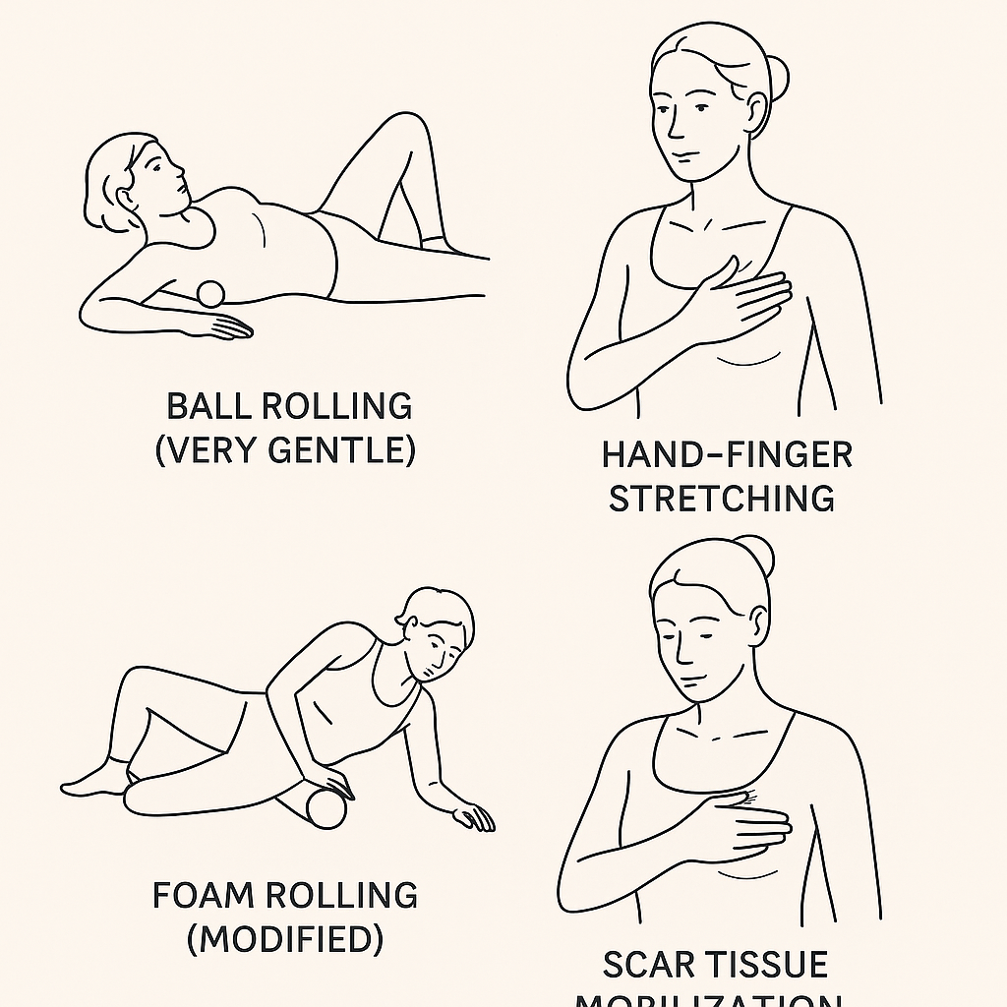
Methods to release facia post mastectomy:
Key Tips:
Always warm up the area first (light heat pad or warm shower).
Never force pressure — fascial release should be mildly uncomfortable but never painful.
Focus on breathing during release: deep belly breathing helps muscles and fascia soften naturally.

Slide 8
Menopause:
Menopause is the natural stage in a woman’s life when her menstrual periods permanently stop because the ovaries stop releasing eggs and producing as much estrogen and progesterone (the main female hormones).
It usually happens between ages 45 and 55, though it can be earlier or later.
Menopause is officially diagnosed when a woman has gone 12 months without a period (and no other medical cause)

Slide 9
Menopause and sports performance:
1. Loss of Muscle Mass and Strength
Lower estrogen levels lead to faster muscle loss (called sarcopenia) and reduced muscle recovery.
This can mean less power, lower endurance, and slower strength gains unless training is adjusted.
2. Reduced Bone Density
Menopause speeds up bone thinning (osteoporosis risk), making women more prone to injuries like fractures, especially in impact sports.
3. Changes in Body Composition
More fat mass tends to accumulate (especially around the waist) and lean muscle decreases.
This can affect speed, agility, and stamina unless specifically addressed with strength and endurance training.

Slide 10
(cont)
4. Energy and Recovery Challenges
Lower estrogen can make it harder to use carbohydrates efficiently for quick energy.
Recovery after intense exercise can take longer, meaning more careful planning of rest and nutrition is needed.
5. Thermal Regulation (Hot Flashes, Night Sweats)
Temperature control gets worse: women might overheat faster during exercise or feel fatigued quicker in hot environments.
Dehydration risk can increase too.
6. Mood and Motivation Swings
Hormonal shifts can cause depression, anxiety, irritability, or fatigue, which can make sticking to training routines harder.
Sleep disturbances (common in menopause) can also impact focus and energy levels

Slide 11
Maintaining a healthy weight during menopause:
Strength Training | Build and maintain muscle with 2–3 sessions/week; boosts metabolism.
Smart Nutrition | Prioritize protein, limit refined carbs, eat whole foods.
Control Portion Sizes | Smaller portions needed due to slower metabolism.
Daily Movement | Stay active daily beyond workouts (walking, chores, standing).
Stress Management | Manage stress to reduce cortisol and belly fat storage.
Prioritize Sleep | Get 7–8 hours of sleep to regulate hunger and fullness hormones.
Hydration | Drink around 2 liters of water daily to prevent overeating.
Mindful Eating | Eat slowly, notice fullness, and avoid distracted eating

Slide 12
Cortisol levels in menopause:
Balancing cortisol during menopause is very important because high cortisol (the stress hormone) can worsen weight gain, sleep problems, fatigue, and even hot flashes.
1. Gentle, Consistent Exercise
Moderate-intensity exercise like walking, swimming, yoga, pilates, light strength training helps lower cortisol.
Avoid too much high-intensity or very long endurance training if already feeling stressed — it can spike cortisol more.
2. Prioritize Deep Sleep
Make sleep sacred: dark, cool room, calming bedtime routine.
Go to bed and wake up at the same time daily.
Lack of sleep dramatically raises cortisol.
3. Practice Relaxation Techniques
Try daily deep breathing, mindfulness, or meditation.
Even 5–10 minutes can bring cortisol levels down.
Progressive muscle relaxation or calming music before bed is amazing.
4. Balanced Nutrition
Eat enough calories — under-eating raises cortisol.
Include complex carbs (sweet potatoes, oats, quinoa) to help calm the nervous system.
Don't skip meals: Steady eating keeps blood sugar stable, which lowers cortisol.

Slide 13
(cont)
5. Caffeine Awareness
Reduce caffeine intake, especially after noon.
Too much caffeine = spikes cortisol and worsens anxiety or hot flashes.
6. Daily Sunlight and Outdoor Time
Natural light exposure helps reset your circadian rhythm and regulates cortisol naturally.
Even 15–20 minutes in the morning helps a lot.
7. Set Boundaries and Manage Emotional Stress
Say no to unnecessary commitments.
Protect quiet time, hobbies, and social time that refills your energy.
8. Adaptogenic Herbs (with Doctor’s Approval)
Some women use herbs like ashwagandha, rhodiola, or holy basil to help manage stress responses.

Slide 14
Treatment options in menopause:
1. Hormone Therapy (HRT)
Estrogen therapy (combined with progesterone) replaces the hormones the body no longer makes.
Best for: Hot flashes, night sweats, vaginal dryness, preventing bone loss
Forms: Pills, patches, gels, sprays, vaginal rings. Important: Needs to be carefully discussed with a doctor because of risks like blood clots, stroke, or breast cancer depending on your health history.
🌿 2. Non-Hormonal Medications: For women who can't or don't want to take hormones: SSRIs or SNRIs (low-dose antidepressants) — can reduce hot flashes and mood swings. Gabapentin — helps with hot flashes, especially at night.
🛡️ 3. Lifestyle and Natural Approaches: Exercise: Strength training + moderate cardio helps maintain weight, bone, and mental health.
Nutrition: High in fiber, calcium, and phytoestrogens (like flaxseeds, soy).
Stress reduction: Mindfulness, yoga, tai chi, deep breathing.
Sleep hygiene: Very structured routines to help deal with insomnia.
🌼 4. Complementary and Alternative Medicine: Herbal therapies (with caution):Black cohosh, red clover, evening primrose oil. (Important: Not all herbs are proven safe or effective. Always discuss with a healthcare provider.)

Slide 15
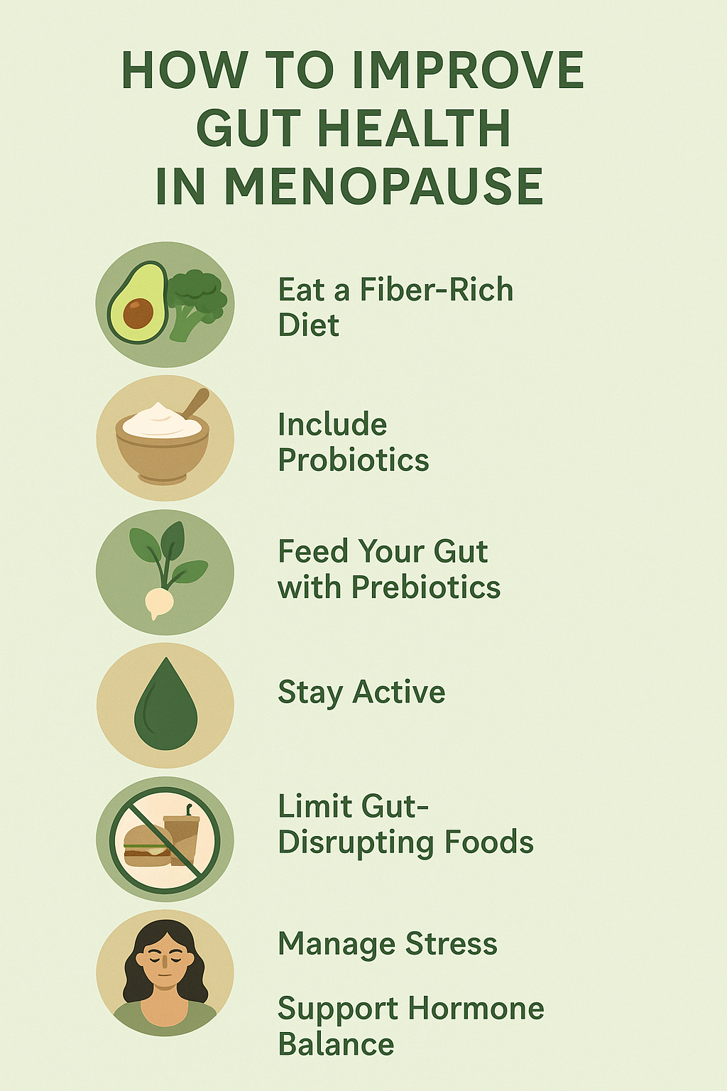
Gut health is super important during menopause because hormone changes (especially lower estrogen) can really shift your gut bacteria, digestion speed, and even immune health.

Slide 16
Strength training in menopause is important for building strength, protecting bone health, maintaining muscle mass, and protecting joints.
Day 1: Lower Body Focus
Bodyweight Squats – 3 sets of 12 reps
Glute Bridges – 3 sets of 12 reps
Step-Ups (onto a stable chair or box) – 3 sets of 10 reps per leg
Calf Raises – 2 sets of 15 reps
Core: Dead Bug or Bird Dog – 2 sets of 10 reps per side
Day 2: Upper Body Focus
Wall or Counter Push-ups – 3 sets of 10–12 reps
Bent-Over Dumbbell Rows (or water bottles) – 3 sets of 12 reps
Overhead Dumbbell Press – 3 sets of 10 reps
Bicep Curls – 2 sets of 12 reps
Tricep Kickbacks – 2 sets of 12 reps
Day 3: Full Body + Balance
Chair Squats (sit-to-stand from a chair) – 3 sets of 12 reps
Dumbbell Deadlifts (light to moderate weight) – 3 sets of 10 reps
Standing Dumbbell Shoulder Press – 2 sets of 10 reps
Standing Balance Hold (on one foot) – 3 x 30 seconds per foot
Plank (knees or toes) – Hold 15–30 seconds x 2 sets
🛡️ Important Reminders:
Rest 30–60 seconds between sets.
Use light to moderate weights (something you can lift with good form but feels challenging by the last 2 reps)
.Focus on form over speed.
Progress slowly: Add a little weight or extra reps only when it feels easy.
Include a 5-minute warm-up (march in place, arm circles, leg swings) and cool-down (gentle stretching).

Slide 17
Helpful supplements in menopause:
Supplement | Why It's Helpful
Calcium | Supports bone health, helps prevent osteoporosis. (1000–1200 mg/day total)
Vitamin D | Boosts calcium absorption, supports mood and immunity. (1000–2000 IU/day)
Magnesium | Helps with sleep, relaxation, mood, and bone strength.
Omega-3 Fatty Acids | Reduces inflammation, supports heart, brain, and joint health.
B-Complex Vitamins | Maintains energy, supports stress management and brain function.
Probiotics | Supports gut health, digestion, immune function, and hormone balance.
Collagen Peptides | Improves joint health, skin elasticity, and bone strength.
Phytoestrogens | Mildly mimics estrogen, may ease hot flashes and hormonal symptoms.
Ashwagandha | Helps with stress resilience, better sleep, and cortisol balance.
Black Cohosh | May relieve hot flashes and mood swings (use cautiously and short-term)

Slide 18
