Slide 1
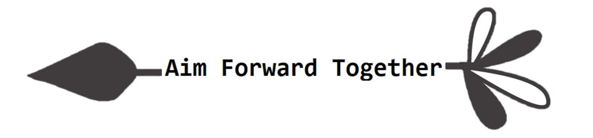


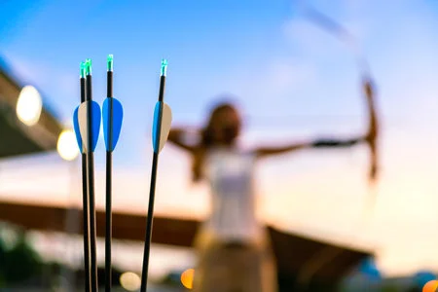



Women In IFAA
Rovaniemi
FINLAND
02 July 2023
Be prepared for the Ranges
Sleep Hygiene
Deal with the “Midnight Sun“
Phrases/Key Words in Finnish
www.ifaa-archery.org

Slide 2




WORDS IN FINNISH ARE PRONOUNCED AS THEY ARE WRITTEN
BE PREPARED FOR THE RANGES
One of the best ways to prepare for any event is to Expect The Unexpected. Equipment can break or become misplaced. Bring back-up equipment and tools so that you can continue to compete to the best of your ability. Other than the obvious extra arrows, release aid, prepare a “First Aid“ tool kit with Serving String, peeps, nocks, insulation tape, glue, etc. All the tools you would need in case of an equipment emergency.
Arrive early to the tournament to give you time to double-check all your equipment.
Prepare for the environmental factors. Different weather conditions like wind, rain or intense heat can all change how you and your bow performs and its accuracy.
Wind: A headwind or tailwind will raise or drop your arrow’s point of impact by altering its speed. When shooting into a headwind, the arrow will slow down and hit low on your target. Shooting in a tailwind will decrease the drag, pushing the arrow towards the target and making it high.
Rain: Heavy rain can cause your arrow to drop faster making your shot hit lower than intended. A rain jacket, hat and arm guard are essential gear for shooting in the rain.
Shade: The stark difference shooting from shade into bright sunlight can throw off your depth perception and make it more difficult to accurately judge distance.
Terrain: Uneven rocky or muddy terrain demands good Hiking Boots. Sneakers will not survive and might be a safety hazard.
Clothing: Layer clothing. Loose the weight. Keep your backpack or quiver as light as possible with only the necessities to feel comfortable walking on the range.
Water/Food: Carry sufficient water and nutritional snacks to keep hydrated and your energy levels consistent during the day.
Hello: Hei / Moi / Terve
Good Morning: Hyvää huomenta
Good Afternoon: Hyvää päivää
Good Night: Hyvää yötä
Thank You: Kiitos
Can you help me please?
Voitko auttaa minua?
Help!: Apua!
How are you?: Mitä kuuluu?
Archery: Jousiammunta
Arrows: Nuolet
Mosquito: Hyttynen
Water: Vesi
Wine: Viini
Beer: Olut
Restaurant: Ravintola
Reindeer: Poro
Santa Claus: Joulupukki
Sport Centre: Urheilukeskus
Fun profile to follow about the Finnish language @veryfinnishproblems (Facebook/Instagram/Twitter/TikTok)

Slide 3

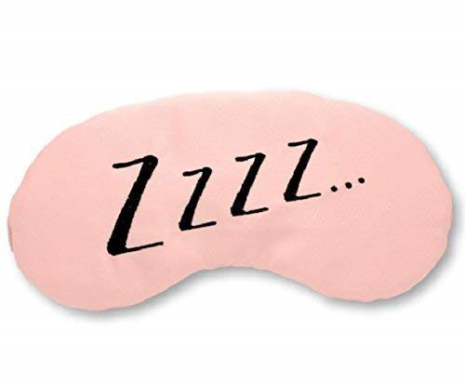
Some Hints and Tips to deal with the “Midnight Sun”!
30 Minutes For Winding Down: Take advantage of whatever puts you in a state of calm such as soft music, light stretching, reading, and/or relaxation exercises.
Dim Your Lights: Black out your room if possible. Keep away from bright lights as they can hinder the production of melatonin, a hormone that the body creates to facilitate sleep.
Unplug From Electronics: A 30-60 minute pre-bed buffer time - device-free. Cell phones, tablets, and laptops cause mental stimulation that is hard to shut off and also generate blue light that may decrease melatonin production.
Test Methods Of Relaxation: It’s often easier to focus on Relaxation. Meditation and other relaxation techniques to put you in the right mindset for bed.
Don’t Smoke: Nicotine stimulates the body in ways that disrupt sleep, which explain why smoking is correlated with numerous sleeping problems.
Reduce Alcohol Consumption: Alcohol may make it easier to fall asleep, but may cause dehydration and disrupt sleep. As a result, it’s best to moderate alcohol consumption and avoid it later in the evening.
Cut Down On Caffeine: Caffeine can keep you wired even when you want to rest, so try to avoid it later in the day.
Don’t Dine Late: Any food or snacks before bed should be on the lighter side.
Finnish grocery stores and supermarkets have a wide selection of daily supplies. The nearest shops to Santa Sport competition centre are in:
Ounasvaaran Kauppakeskus Mall:
(950m - Ounasvaarantie 15)
K-Supermarket Ounasvaara:
Ounas Apteekki (Pharmacy)
Ounas Ateria (Lunch, pizzas and burgers)
There are two malls in the City Centre: Revontuli Mall (Koskikatu 27) and
Sampo-keskus (Maakuntakatu 29-31)
There you can find all sorts of shops, restaurants, cafes, groceries etc.
In Sampo-keskus there is also a pharmacy called Sampo Apteekki.
In the City Centre of Rovaniemi by Lordi´s Square there is a small grocery store which is open 24/7: Sale Lapinmaa (Koskikatu 11).
There are also bigger supermarkets and pharmacies outside the city centre:
Prisma and Rovaniemen Keskusapteekki (Teollisuustie 2), Lidl (Oijustie 2), Citymarket (Pulkamontie 1), and Lidl and Saarenkylän Apteekki (Pulkamontie 2).
In Finland you can buy mild alcoholic beverages in grocery stores but strong alcoholic drinks only in Alko. The sale of alcoholic beverages starts at 9am and ends 9pm because of alcohol legislation. There are three Alko’s in Rovaniemi: You can find them in Prisma, Revontuli Mall and in Citymarket.

Slide 4


Women In IFAA Workgroup
“We need women at all levels… to change the dynamic, reshape the conversation, to make sure women’s voices are heard and heeded, not overlooked and ignored.”
— Sheryl Sandberg
The Women in IFAA Workgroup was initiated in February 2021. The Workgroup meets monthly on 2nd Tuesday of the month via Google Meet. The brief for the Workgroup is to develop gender equity policies targeting gender balance in leadership, administration, coaching and to encourage female participation in archery and remove any negative association in a male dominated sport.
A priority for the Workgroup is to develop awareness programs for the Women in IFAA at international tournaments such as the World Championships. Since 2022 the Workgroup initiated 3 events with this one being the 4th.
As from the 1st of June 2023, Jo Healey from the EFAA (England) will chair the Workgroup. This will allow me to focus on other development programs within the IFAA. I am looking forward to the initiatives Jo will bring to the table by discussing women related topics.
Marietjie Fryer -- IFAA Vice President Development
Women In IFAA Contacts
Below are the names and contact details of our Women in IFAA focusing on the European Region. Should you want to get involved in the Workgroup or in your local club, national association or community, reach out and get connected.
Jo Healy (England) : healey1@btinternet.com
Marietjie Fryer (South Africa) : vp-development@ifaa-archery.org
Lynn Ellingworth (Ireland) : secretary@ifaa-archery.org
Saskia Brouwer (France) : saskia@ifaa-europe.com
Ülle Kell (Estonia) : ulle.kell@gmail.com
Flavia Arioni (Italy) : flavia.arioni@gmail.com
Ash Cowie (England) : lotafisa@ifaa-archery.org
Emergency Contact
Finnish Red Cross Rovaniemi is responsible for the First Aid in case of accidents and/or illnesses that occur during the competition.
Call tel. +358 40 7731 658

